Slide 1
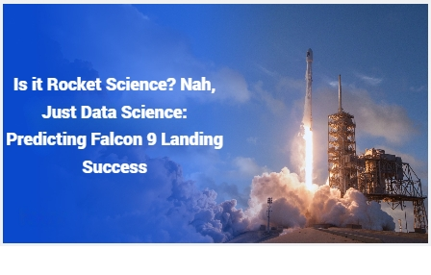

Written By :- Raj Shah
15th April 2024
Contact no. :- +91 9313904843

Slide 2

Outline
Table of Contents
Executive Summary
Introduction
Methodology
Results
Conclusion
Appendix

Slide 3
Table of Contents
No. | Subject | Contents | Page no.
1) | ABSTRACT | Executive Summary of the Project | 6
2) | INTRODUCTION | Introduction to the Problem and Project objectives | 7
 | SECTION - 1
3) | METHODOLOGY | Project Methodology Summary | 9
4) | Data Collection Methodology | Data Collection using APIs and Web Scraping | 10-12
5) | Data Wrangling Methodology | Data Cleaning and Organizing | 13
6) | Exploratory Data Analysis | EDA using Data Visualization and SQL | 14-15

Slide 4
No. | Subject | Contents | Page no.
7) | Launch Site Visualization using Folium | Interactive Folium Map | 16
8) | Dashboard Building using Plotly and Dash | Interactive Dashboard Visualization using Plotly and Dash | 17
9) | Predictive Analysis & Results | Model Building for Binary Classification using various Sklearn models and validation techniques | 18-19
 | SECTION - 2
10) | Insights drawn from EDA | -- | 21-36
 | SECTION – 3
11) | Launch Site Proximity Analysis | -- | 38-40
 | SECTION - 4
12) | Findings from Dashboard Analysis | -- | 42-44

Slide 5
No. | Subject | Contents | Page no.
 | SECTION-5
13) | Results from Model Building, Evaluation and Refinement | Comparison between different results from different Binary Classification models and selection of Best Model. | 46-47
14) | Conclusion | -- | 48
15) | Appendix | -- | 49

Slide 6
Abstract
SpaceX's Falcon 9 rocket has revolutionized space travel with its reusability. However, a critical factor in launch economics is whether the first stage successfully returns and lands. This project explores the power of data science in predicting the landing success of Falcon 9 launches.
Leveraging historical SpaceX launch data, we employ machine learning models to identify key factors influencing landing outcomes.
This project aims to contribute to a more efficient and cost-effective future for space exploration by providing valuable insights for SpaceX and similar launch providers. It demonstrates the potential of data science in optimizing launch strategies and ultimately, making space travel more accessible.

Slide 7
Introduction
Project background and context
SpaceX advertises on their website about Falcon 9 rocket that launches with its cost of only 62 million dollars, while other providers’ rocket could cost up around 165 million dollars each. The reason why SpaceX rocket cost incredibly low is due to they are able to reuse the first stage of their rockets.
If we can determine the first stage success landing rate, we could determine the cost of their product. This information can be used if an alternate company wants to bid against SpaceX for rocket launch
Problems you want to find Solutions for
The objective of this project is to find the probability of the Falcon 9 first stage successful landing. Can we predict the Landing outcome of a Falcon 9 rocket using past launch data and ML models ?

Slide 8

Section 1

Slide 9
Methodology
Data Collection Methodology
※Data has been collection from various sources on the Internet. We have collected some data from the Wikipedia pages about SpaceX rocket launches and some other sites using Web-scraping by BeautifulSoup objects and rest of the data has been imported from SpaceX API.
Perform data wrangling
※ Data is processed by using several API such as Python Pandas, Numpy, Seaborn, SQL query, etc.
Perform Data Visualization
※ Exploratory data analysis (EDA) using Python’s Data Visualization libraries like Seaborn and Matplotlib.
※ Perform Interactive visual analytics using Folium and Plotly Dash
Perform predictive analysis using classification model
※Logistic Regression, Support Vector Machine, Tree Classifier, K-Nearest Neighbors have been used for building a Binary Classification model.

Slide 10
Data Collection
Data sets are mainly collected by using the python functions.
Data is collected from various source, such as SpaceX API, Wikipedia, and other website links.
The data are then read and converted into Python Pandas API for further analyzing.
The data is also saved into csv file format .

Slide 11
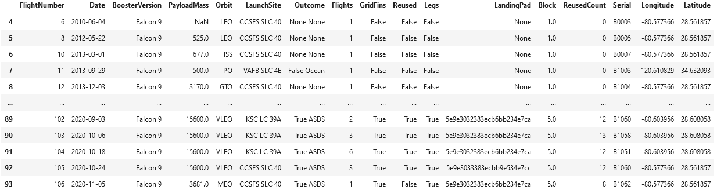
Data Collection – SpaceX API
Used Python requests.get() to below SpaceX API links to collect information:
https://cf-courses-data.s3.us.cloud-object-storage.appdomain.cloud/IBM-DS0321EN-SkillsNetwork/datasets/API_call_spacex_api.json
https://api.spacexdata.com/v4/rockets/
https://api.spacexdata.com/v4/launchpads
https://api.spacexdata.com/v4/payloads/
https://api.spacexdata.com/v4/cores/
https://api.spacexdata.com/v4/launches/past
All collected data is then converted in Python Pandas API Data frame and CSV file format .
Then, filter out other rocket launches and only keep Falcon 9 rocket information.
GitHub URL:
https://github.com/Rajshah296/IBM_Data_Science.git
File name:
jupyter-labs-spacex-data-collection-api.ipynb

Slide 12
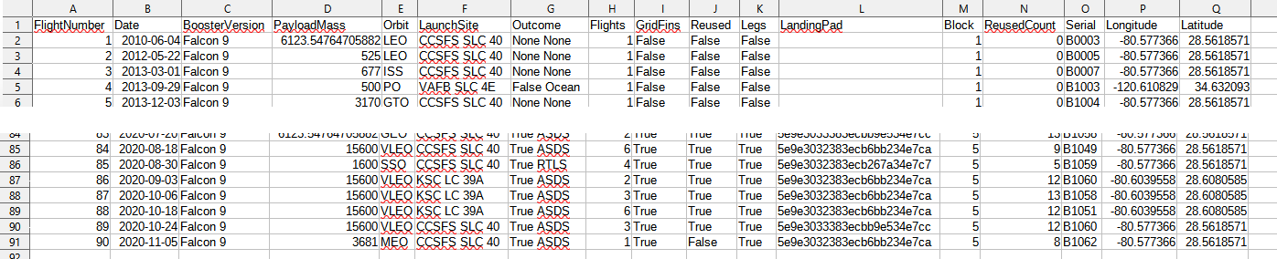
File name:
jupyter-labs-webscraping.ipynb
Data Collection - Scraping
Used Python requests.get() and Beautiful Soup API function to below Wikipedia links to collect information from a table in the website:
https://en.wikipedia.org/w/index.php?title=List_of_Falcon_9_and_Falcon_Heavy_launches&oldid=1027686922
The Web scrapping processed also including extracting column/header, parsing HTML table, and converting into Python Pandas API Data frame format and CSV file format.
GitHub URL:
https://github.com/Rajshah296/IBM_Data_Science.git
File name:
jupyter-labs-webscraping.ipynb

Slide 13
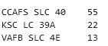
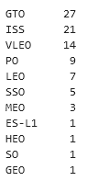
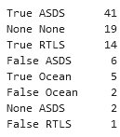
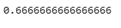
Data Wrangling
The collected data is further processed to further understand it:
Drop the irrelevant columns from the dataset.
Replace missing values with mean of other values
Calculate number of rocket launch site, orbit, launches count, and landing outcomes
Simplify landing outcome into numeric data (Fail : 0 and Success : 1)
Applied one-hot encoding on various categorical features of the dataset like Serial number, Flights, Reused,etc.
Calculate landing success rate based on past data
Launch site:
Orbit:
Landing outcomes:
Landing success rate:
*[CCAFS LC 40]
also come out on later data
GitHub URL:
https://github.com/Rajshah296/IBM_Data_Science.git
File name:
labs-jupyter-spacex-Data wrangling.ipynb

Slide 14
EDA with Data Visualization
For Exploratory Data Analysis (EDA), several graph/chart have been created :
Scatter plot (Flight Number vs. PayloadMass, and Landing outcomes)
Scatter plot (Flight Number vs. Launch site, and Landing outcomes)
Scatter plot (Payload Mass vs. Launch site, and Landing outcomes)
Bar chart (Orbit and Landing outcomes)
Scatter plot(Flight Number vs. Orbit, and Landing outcomes)
Scatter plot(Payload Mass vs. Orbit, and Landing outcomes)
Line chart (Year vs. Success rate)
Each plot and chart figure will be shown on later slides.
GitHub URL:
https://github.com/Rajshah296/IBM_Data_Science.git
File name:
jupyter-labs-eda-dataviz.ipynb.jupyterlite.ipynb

Slide 15
EDA with SQL
For Exploratory Data Analysis (EDA) with SQL :
For this analysis, another data is extracted and analyzed
https://cf-courses-data.s3.us.cloud-object-storage.appdomain.cloud/IBM-DS0321EN-SkillsNetwork/labs/module_2/data/Spacex.csv
Check all launch site list (4 Launch sites are available in the data)
Check Total Payload Mass (kg) : 45,596kg
Check Average Payload Mass (kg) : 2,928kg
Check dates of launch (Such as the earliest date launch record is on 4th Oct 2010)
Check list of Booster Version
Check count of the recorded mission’s success and failure
Check the which Booster Version has the max Payload Mass
Check failure measure in within certain date
GitHub URL:
https://github.com/Rajshah296/IBM_Data_Science.git
File name:
jupyter-labs-eda-sql-coursera_sqllite.ipynb

Slide 16
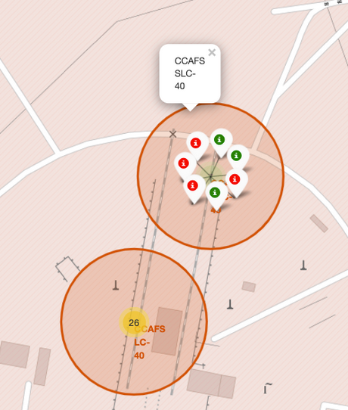
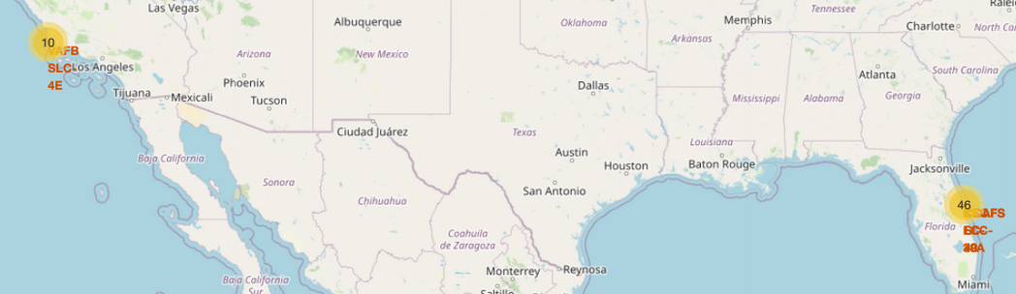
Build an Interactive Map with Folium
With Interactive Map Folium, some important location can be visualized on map :
Location of launch sites
Location of NASA Johnson Space Center at Houston Texas
Colored markers and label popups are also inserted into the map
Count of success and failure of launch also insert into the map
Nearest coastline from some launch site also marked, line drawn and its distance is calculated
GitHub URL:
https://github.com/Rajshah296/IBM_Data_Science.git
File name:
jupyter-labs-eda-sql-coursera_sqllite.ipynb

Slide 17
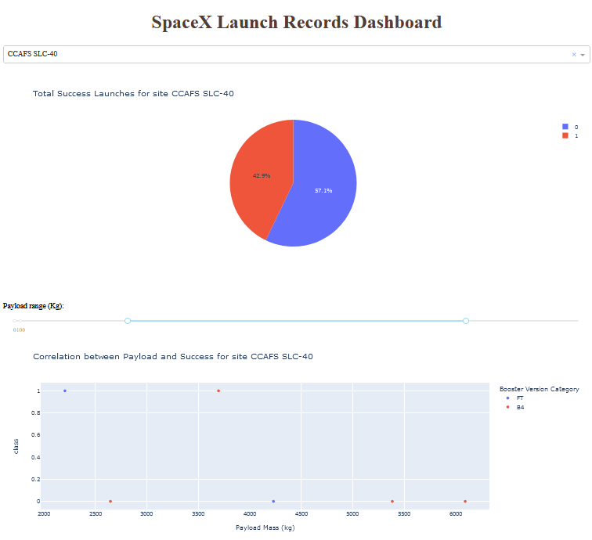
Build a Dashboard with Plotly Dash
A dashboard is created with below function:
Pie chart and Scatter plot as output
Pull down and numerical slider as input
Depends on input, the output will change in real time
If pull down input ‘ALL’ is selected, Pie Chart will show the ratio of successful landing on all launch site.
If pull down input launch site name is selected, Pie Chart will show the ratio of success and failure of landing of the site
The numerical slider is for Pay load Mass.
The Scatter plot, which is Pay load mass vs. Success rate, will change in real time according to input of numerical slider and selected launch site.
GitHub URL:
https://github.com/Rajshah296/IBM_Data_Science.git
File name:
spacex_dash_app.py

Slide 18
Predictive Analysis (Classification)
For predictive analysis, machine learning method is used
For machine learning, 80% of data is assigned for Training, 20% is assigned for Test.
Predictive analysis has been conducted by using GridSearchCV function from Scikit-Learn API
Logistic Regression, Support Vector Machine, Tree Classifier, K-Nearest Neighbour objects have been used on GridSearchCV function.
Each result is then compared to find the best prediction method.
GitHub URL:
https://github.com/Rajshah296/IBM_Data_Science.git
File name:
spacex_dash_app.py

Slide 19
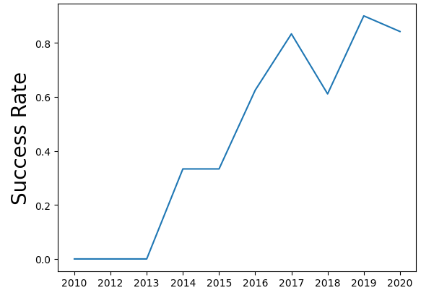
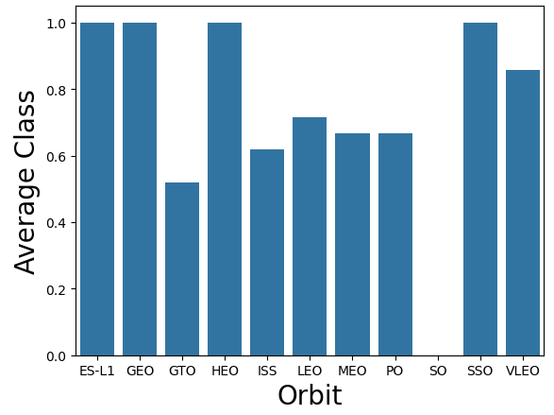
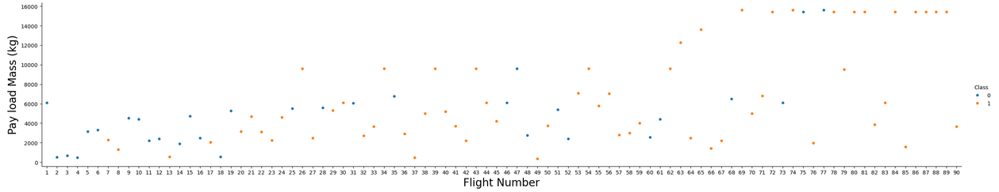
Results
Exploratory data analysis results
Predictive analysis results
Tree classifier method has shown higher evaluation for Predictive analysis
Its score is 0.9027777777777778 (Nearer to 1 is best result)
Interactive analytics demo in screenshots

Slide 20

Section 2

Slide 21
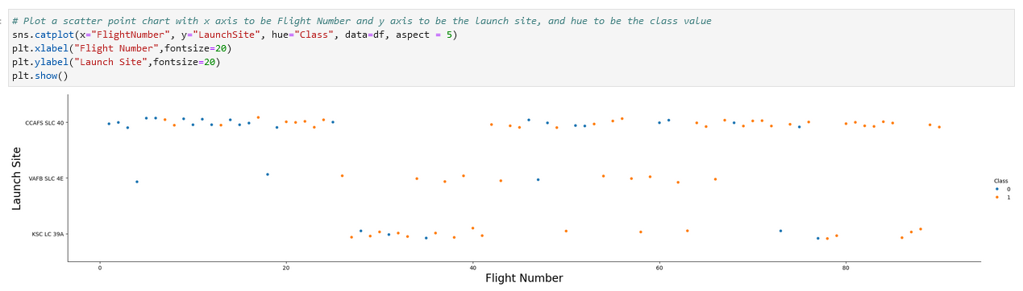
Flight Number vs. Launch Site
CCAFS-SLC-40 Launch site has the most launch count
CCAFS-SLC-40 Launch site has lots of failed landing, but more successful latter
KSC-LC-39A only has most launch while other site do not

Slide 22
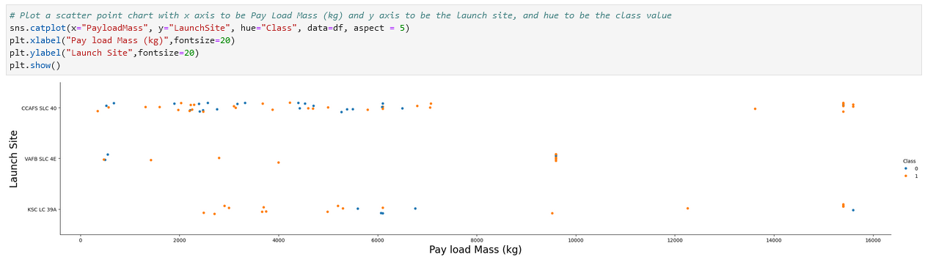
Payload vs. Launch Site
Most launch has less than 8,000 kg pay load
CCAFS-SLC-40 and KSC-LC-39A has high pay load mass launch, but VAFB-SLC-4E do not.
VAFB-SLC-4E mostly launch middle pay load around 9,000 ~ 10,000 kg

Slide 23
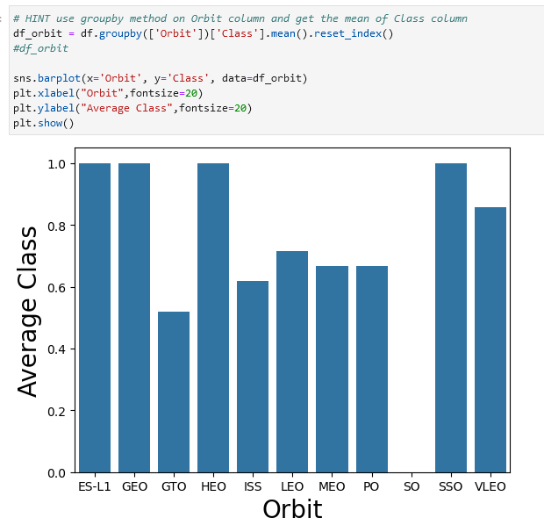
Success Rate vs. Orbit Type
ES-L1, GEO, HEO, and SSO orbit has very high success rate
SO orbit has lowest success rate
Other orbits have more than 50% of success rate

Slide 24
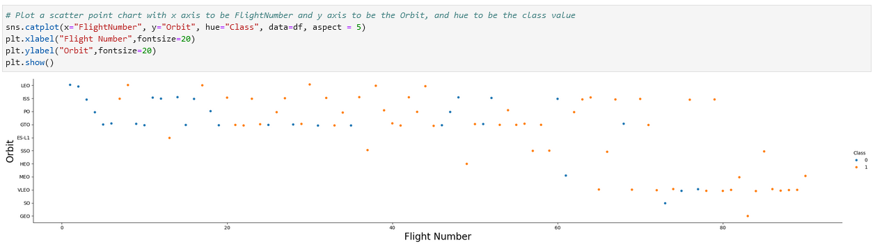
Flight Number vs. Orbit Type
Most of launch are to LEO, ISS, PO, GTO orbit
Not much launches for EL-L1, SSO, HEO, VLEO, SO, GEO orbit
Lots of launch for VLEO orbit later on

Slide 25
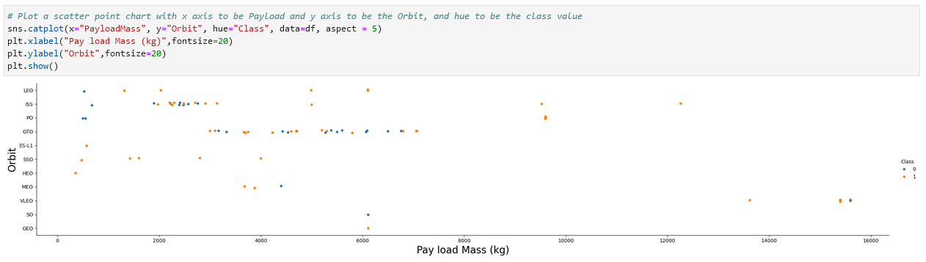
Payload vs. Orbit Type
GTO orbit mostly has launch with around 3,000 ~ 8,000 kg payload mass
ISS orbit mostly has payload mass around 2,000 ~ 4,000 kg
VLEO orbit only have high payload mass, which is around 13,000 ~ 16,000 kg

Slide 26
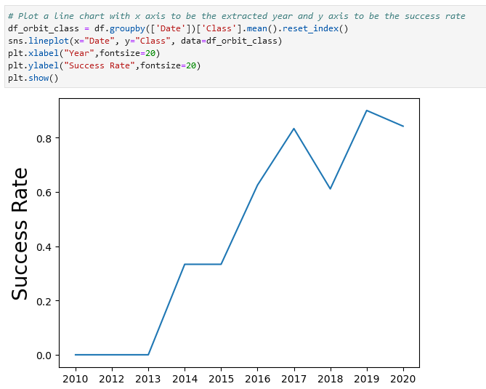
Launch Success Yearly Trend
Success rate since 2013 kept increasing till 2020
There is only small flop around 2019

Slide 27
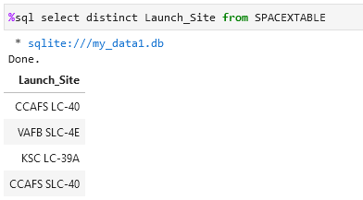
All Launch Site Names
There are 4 launch sites:
CCAFS LC-40
VAB SLC-4E
KSC LC-39A
CCAFS SLC-40

Slide 28
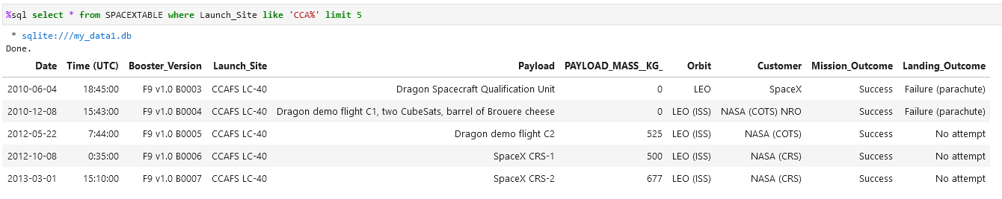
Launch Site Names Begin with 'CCA'

Slide 29
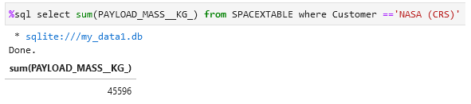
Total Payload Mass

Slide 30
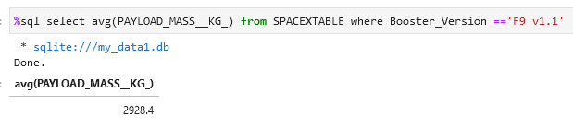
Average Payload Mass by F9 v1.1

Slide 31
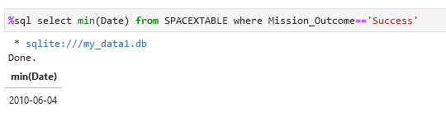
First Successful Ground Landing Date

Slide 32
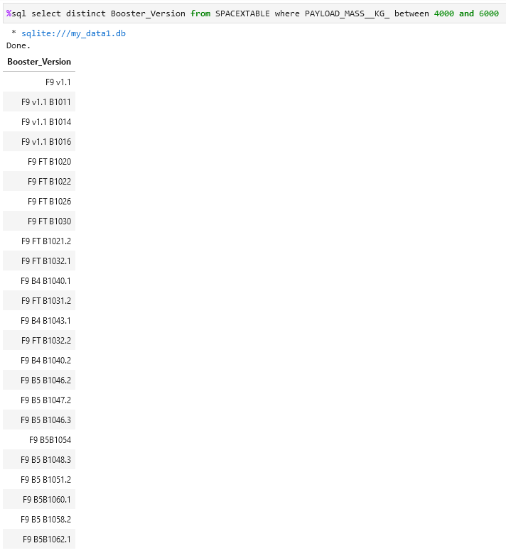
Successful Drone Ship Landing with Payload between 4000 and 6000

Slide 33
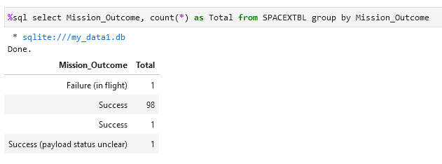
Total Number of Successful and Failure Mission Outcomes
Success : 100
Fail : 1
*Mission outcomes is not same as failure or success of landing

Slide 34
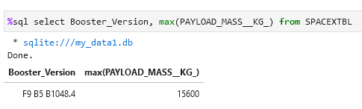
Boosters Carried Maximum Payload

Slide 35
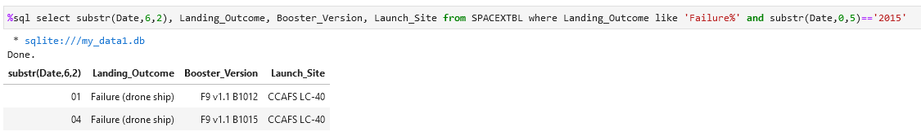
2015 Launch Records

Slide 36
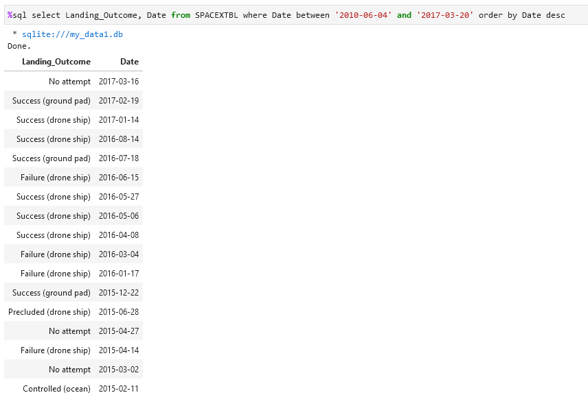
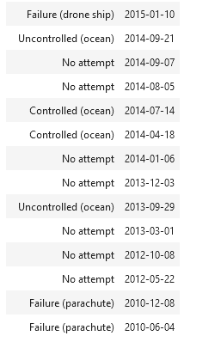
Rank Landing Outcomes Between 2010-06-04 and 2017-03-20

Slide 37

Section 3

Slide 38
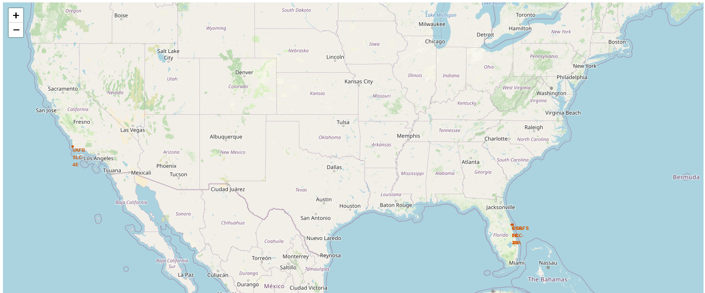
<Folium Map Screenshot 1>
SpaceX Launch Site Location
All launch site location are near coastline
Only VAFB SLC-4E at the Westcoast. Other launch site are at Eastcoast

Slide 39
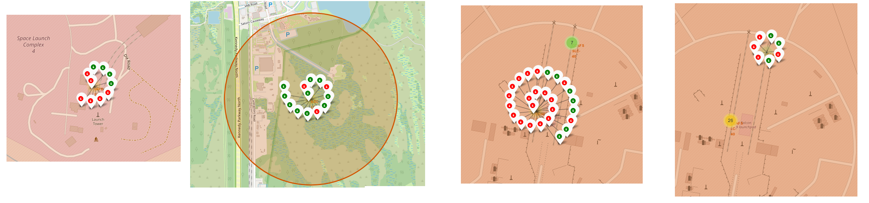
<Folium Map Screenshot 2>
VAB SLC-4E
KSC LC-39A
CCAFS LC-40
CCAFS SLC-40
Green : Success
Red : Failure

Slide 40
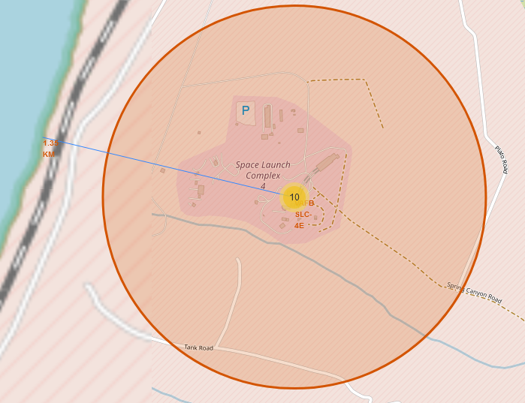
<Folium Map Screenshot 3>
VAB SLC-4E launch site is around 1.35 km away from nearest coast line

Slide 41

Section 4

Slide 42
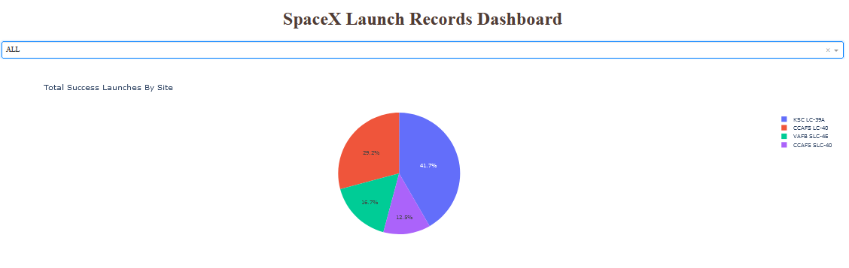
<Dashboard Screenshot 1>
Most success launch are from KSC LC-39A site
Least success launch are from CCAFS SLC-40 site

Slide 43
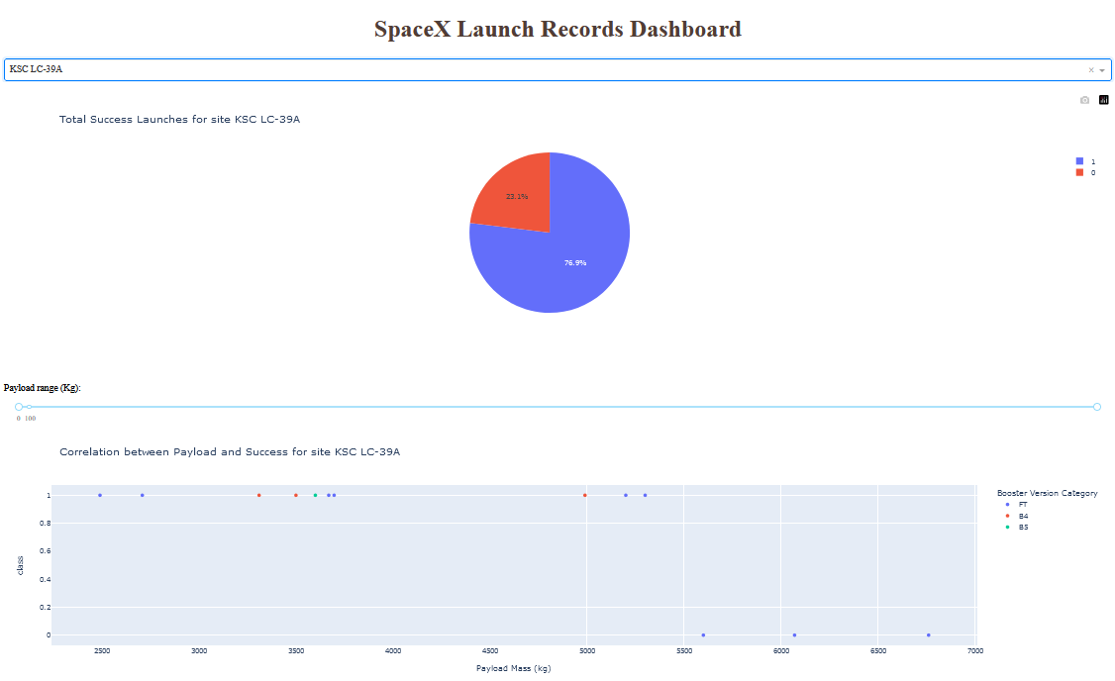
<Dashboard Screenshot 2>
KSC LC-39A success rate is around 76.9%
Higher pay load mass has tendency to be failed

Slide 44
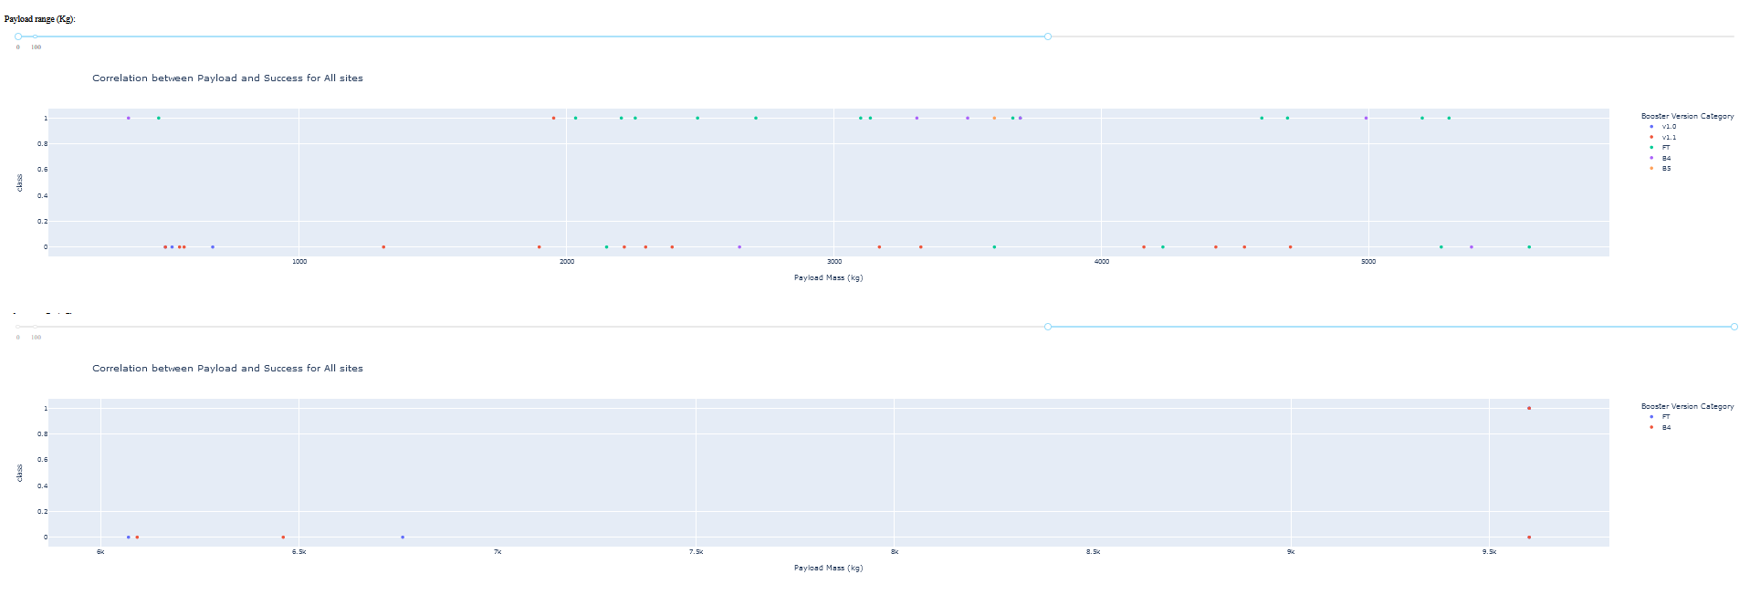
<Dashboard Screenshot 3>
There is not clear success or fail within lower pay load mass
But it become clear success rate is lower with higher pay load mass

Slide 45

Section 5

Slide 46
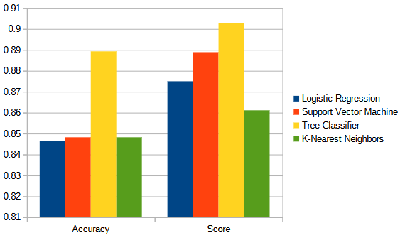
Classification Accuracy
Tree Classifier has most highest accuracy and score

Slide 47
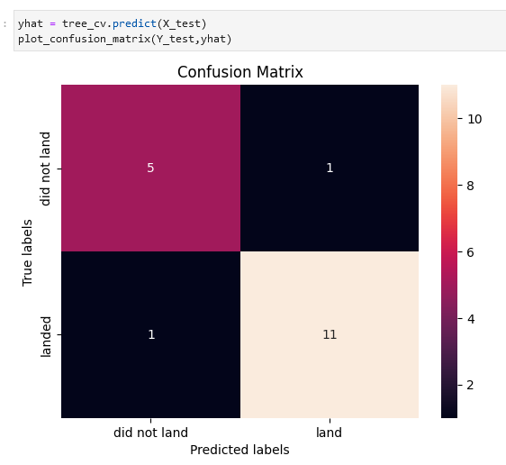
Confusion Matrix
Tree Classifier method predicted 5 launches doesn’t land successfully correctly, while predict wrong 1
Tree Classifier method predicted 11 launches land successfully correctly, while predict wrong 1

Slide 48
Conclusions
Point 1 :
ES-L1, GEO, HEO, and SSO orbit has very high success rate. While SO has very low success rate
Point 2 :
Success rate has been increasing yearly
Point 3 :
Higher pay load mass has tendency to fail.
Point 4 :
Tree Classifier method has the best accuracy when predicting outcome of rocket landing.

Slide 49
Appendix
Include any relevant assets like Python code snippets, SQL queries, charts, Notebook outputs, or data sets that you may have created during this project

Slide 50


